Slide 1
IBM University Engagement Project Submission
“Exploring the Power of Agentic AI with IBM Granite and LangFlow”

Slide 2

Project Tile – Smart Business Idea Generator Agent
Domain of Project – Business
Student Name | Recent Passport Photo | Email ID | Mobile number [WhatsApp]
Mokshith B Abhay |  | mokshithbabhay782@gmail.com | 9731814068

Slide 3
Problem Statement -
Problem Statement : Smart Business Idea Generator Agent
The Challenge
In the digital era, innovation is crucial, but individuals, students, researchers, and organizations
often struggle with idea generation. Brainstorming sessions are unstructured, inspiration is
scattered across articles, videos, and social media, and existing tools focus on text-only prompts
without context-awareness. The challenge is not just to suggest random ideas but to synthesize
creativity, context, and relevance into intelligent, actionable ideas for diverse domains such as
startups, research, content creation, or product development.
The Objective
Build an agentic AI Smart Idea Generator that empowers users with contextual, innovative, and multimodal ideation. The solution should:
Fuse Knowledge Sources: Pull insights from articles, research papers, trend analysis, and social platforms to generate contextual and current ideas.
2. Enable Multimodal Brainstorming: Accept inputs like text prompts, images (e.g., product sketches), or voice notes and refine them into structured, creative suggestions.
3. Create a Predictive & Agentic Layer: Identify trending domains (e.g., AI in healthcare, sustainable energy), forecast idea relevance, and recommend high-impact directions.
4. Visualize Idea Maps: Provide an interactive dashboard that organizes ideas into categories, impact scores, and feasibility maps, helping users explore and refine concepts quickly.

Slide 4
Technology Used
Tech Stack :
I used LangFlow + IBM watsonx.ai + Granite Models

Slide 5
Proposed Solution -
The Smart Business Idea Generator Agent is an intelligent AI-based system developed to help users discover innovative and profitable business ideas based on their interests, skills, budget, and market demand. Many people want to start their own business but struggle to select the right idea due to lack of guidance, market knowledge, or experience. The proposed system acts as a smart virtual assistant that analyzes user inputs such as educational background, hobbies, investment capacity, preferred business field, target customers, and location.
Using Artificial Intelligence, Natural Language Processing (NLP), and Machine Learning algorithms, the system processes this information and generates personalized business ideas that match the user’s profile and current market trends.
The system also performs market trend analysis by studying online business trends, customer preferences, and emerging industries to provide modern and profitable startup suggestions. Along with business idea generation, the agent offers additional information such as estimated startup cost, required resources, risk analysis, expected profit, marketing strategies, and future growth opportunities. The architecture of the system includes modules like user input processing, idea recommendation engine, market analysis module, and business report generation module. The recommendation engine uses machine learning techniques to compare user data with successful business patterns and provide accurate suggestions.

Slide 6
Langflow component Used -
1) Chat Input – Interface where users enter their queries, preferences, or meal details (text/voice/image).
2) IBM watsonx AI Agent - Processes user input using Granite models to generate personalized nutrition insights and recommendations.
3) Name of IBM Granite model - Granite-4.0-8B-Instruct → Fast, efficient for real-time diet recommendations
4) Chat output -Displays AI-generated responses such as diet plans, nutritional analysis, and health suggestions.

Slide 7
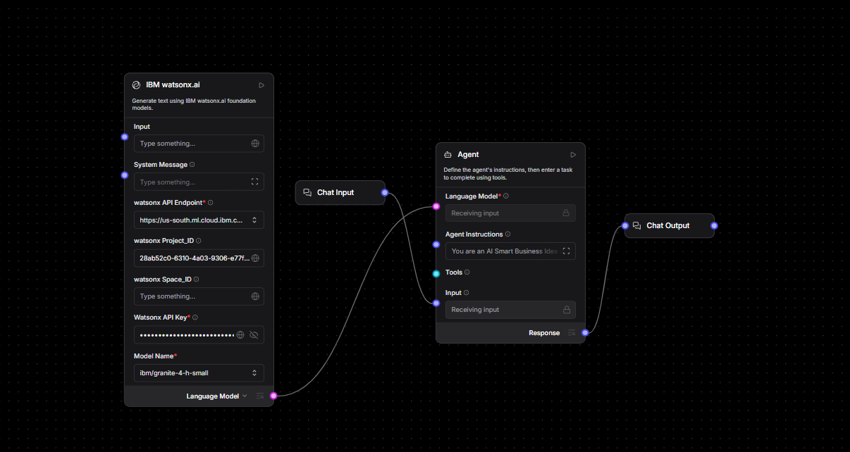
Langflow workflow -

Slide 8

Architecture blueprint

Slide 9

Role of Agentic AI in the solution
Role of Agentic AI in Nutrition Agent
Agentic AI plays an important role in the Smart Business Idea Generator Agent by acting as an intelligent decision-making system that can analyze user requirements, understand market trends, and generate personalized business ideas automatically.
It continuously processes user inputs such as skills, interests, budget, and business goals, then uses AI techniques to recommend suitable and profitable business opportunities. Agentic AI also helps in market analysis, risk prediction, startup planning, and providing smart suggestions, making the system more efficient, accurate, and user-friendly
n this solution, Agentic AI improves accuracy, saves time, reduces manual research, and supports better business decision-making. It creates a more interactive and user-friendly environment where users can easily explore innovative startup ideas and receive intelligent guidance for building successful businesses. By combining automation, learning capability, and decision-making intelligence, Agentic AI becomes the core technology that powers the entire Smart Business Idea Generator system.
.

Slide 10
Technology Used
Langflow platform -For designing and orchestrating multi-agent workflows visually
IBM Grainte model - ibm-granite-4-h-small – s used for generating intelligent business ideas and providing AI-based responses from user inputs.
IBM Cloud – It provides the infrastructure to build, deploy, and scale the Nutrition Agent efficiently. IBM Cloud enables a reliable, secure, and scalable environment for deploying the Nutrition Agent.
IBM Watsonx.ai - For model deployment, embeddings, and AI governance

Slide 11
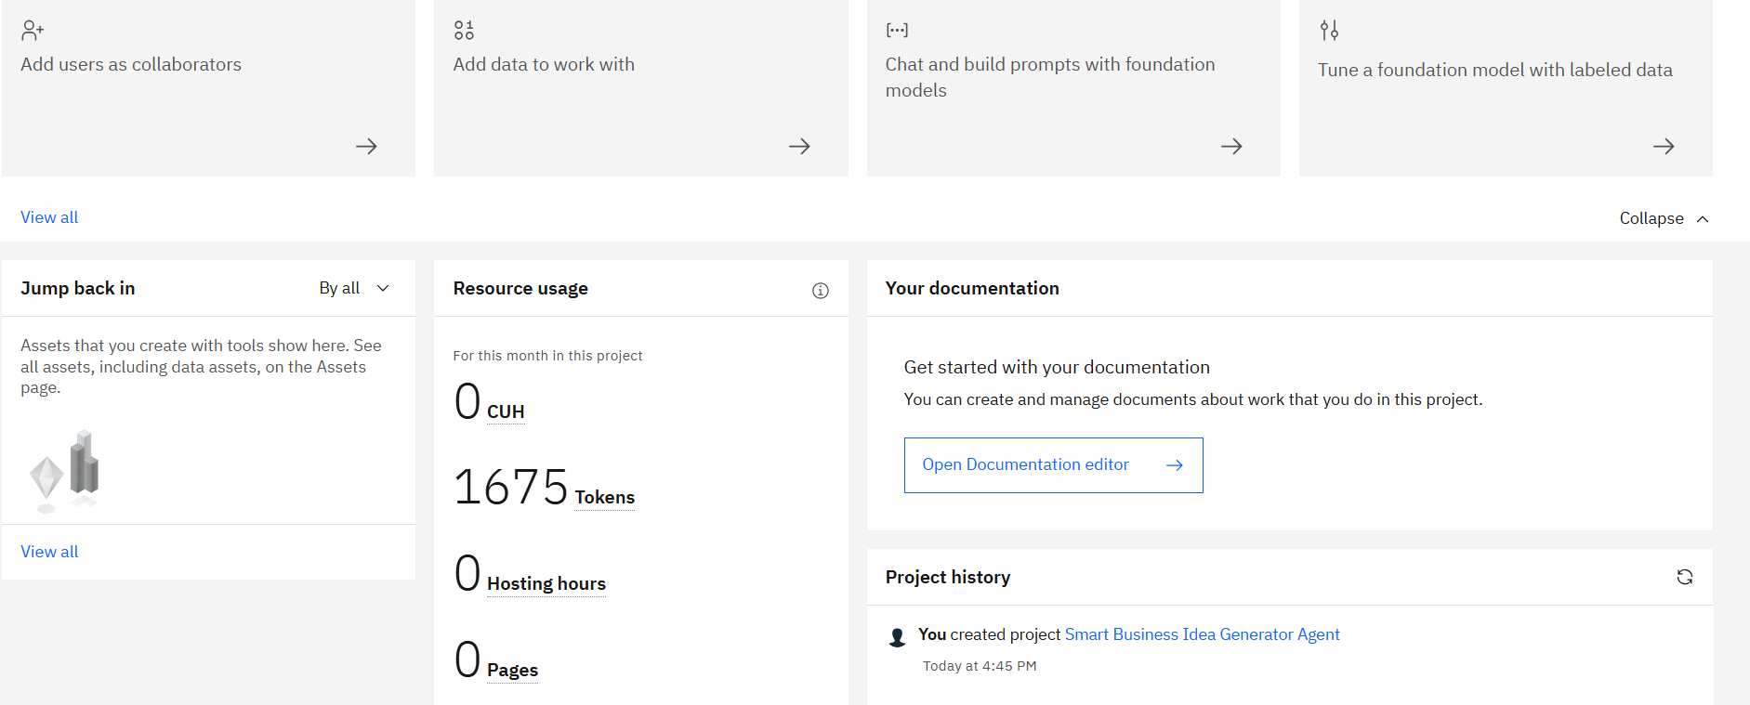
Token Usage
11,761 token are used
·
·
·

Slide 12
Novelty and Uniqueness:
The proposed Smart Business Idea Generator Agent stands out by combining Agentic AI, intelligent recommendation systems, and market trend analysis into a single smart platform.
AI-Powered Business Recommendation – Generates personalized business ideas based on user interests, skills, investment budget, and market demand.
Agentic AI Intelligence – Uses autonomous AI decision-making to analyze user requirements and suggest suitable startup opportunities.
Market Trend Analysis – Studies current and future business trends to provide innovative and profitable business suggestions.
Personalized Entrepreneur Support – Tailors recommendations according to user goals, experience level, and preferred business category.
Startup Planning Assistance – Provides additional insights such as startup cost, expected profit, risk level, and marketing strategies.
Interactive AI Guidance – Acts as a smart virtual business mentor that supports users in business planning and decision-making.
Time-Saving and Automated – Reduces manual research and helps users quickly identify suitable business opportunities.
This makes the solution a smart, adaptive, and AI-driven business advisor rather than just a basic business idea suggestion tool.

Slide 13
Git Hub Link
https://github.com/mokshi2826/Smart-Business-Idea-Generator-Agent
·
·
·

Slide 14
Future Scope
1. Real-Time Market Trend Integration –
The system can be integrated with real-time market analysis tools and online business trend platforms to collect updated information about customer demands, emerging industries, and profitable startup opportunities. This will enable the Smart Business Idea Generator Agent to provide more accurate, innovative, and future-oriented business recommendations based on current market conditions and business growth patterns.
2. AI-Powered Voice Assistant & Multilingual Support –
Enhancing the system with a voice-enabled AI assistant and multilingual support will improve accessibility and user interaction. Users can communicate with the agent using voice commands and receive business suggestions in their preferred language, making the solution more user-friendly, inclusive, and suitable for people from different regions and linguistic backgrounds.
·
·
·

Slide 15


